Slide 2
Bob Teofilo
Products & Services - Hockey
“Video and analytics coming to European Professional hockey”

Slide 3
In the past, teams have relied on sports technology companies that address only one of the following:
Play-by-Play data integration
Producing reports
Video sharing and warehousing
Single game video editing
Video and data distributing

Slide 4
SOLUTION
Rich New Coaching Level Data
Mobile Apps to Send, Receive and Collaborate
Advanced Reports, Analytics and Visuals
Cloud Enabled Editor Leverages Synergy Breakdowns
Game Video Cut to Granular Components
Automated Video Edits Streamed or Downloaded

Slide 5
On-demand professional sports analytics linked to supporting video.
Unified data set the works across all players of all leagues.
End-to-end solution that addresses all aspects of game preparation.

Slide 6
Synergy has been providing services in professional sports for 13 years.
Synergy currently works with every NBA team, NCAA basketball, EuroLeague, FIBA National teams, and many more Elite basketball teams around the world.
Synergy services are used on six (6) continents and over 100 countries.
Synergy is also used by MLB and NCAA baseball teams.

Slide 7
“I love the Synergy product – I show it off to everyone I meet and I use it for hours every day.”
-Lawrence Frank, Los Angeles Clippers Executive Vice President of Basketball Operations
“We’ve used Synergy for several years now. It’s a fantastic product that’s become a key part of our scouting process, and it’s improving every year.”
-Danny Ainge, Boston Celtics President of Basketball Operations

Slide 8
Bob Teofilo
Worked in professional sports for over 10 years
Worked in the Hockey Operations department for eight (8) years of a National Hockey League team.
Worked directly with European hockey teams for six (6) years
Innovative work in Hockey Analytics

Slide 9
World Wide Hockey Video and Analytics
North America Professional
NHL
Event Summary, Game Summary, Play-by-Play, Faceoff Summary, TOI, Shot Report, & Roster Report
AHL/ECHL
Gamesheet
North American Junior and College leagues
OHL/WHL/QMJHL/NCAA/USHL/Tier II Hockey
Game Summary & Play-by-Play
European Professional
KHL, SHL, SM-liiga, top European Leagues
Game Summary, Play-by-Play, & Lineups

Slide 10
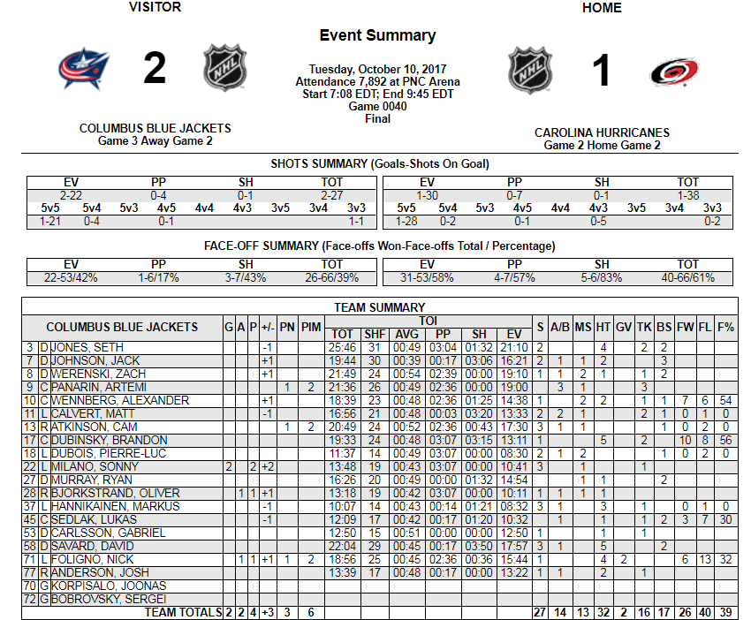

Slide 11
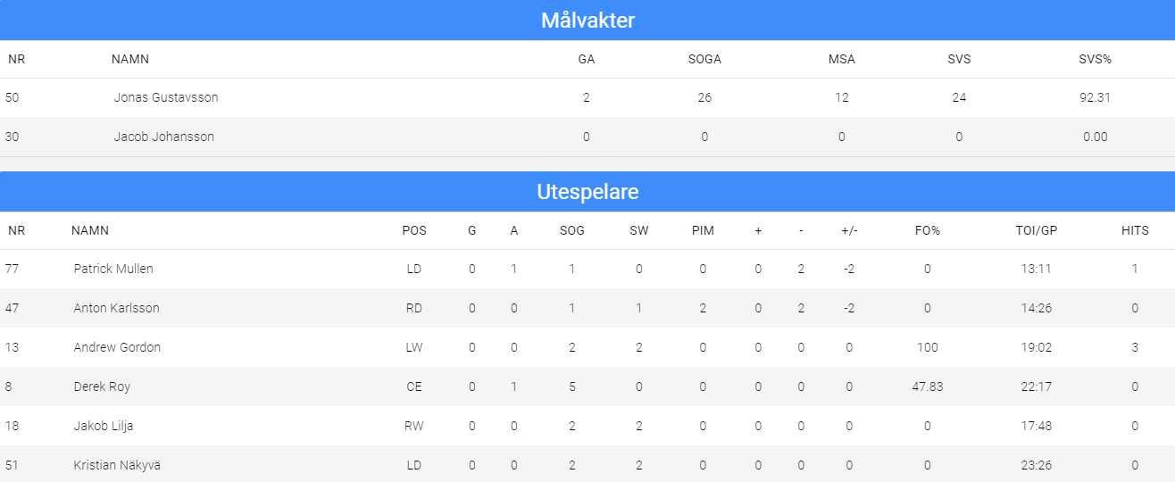

Slide 12
Synergy uses the game video to create data reports
Individual and team reports tied to video playlists.
Open video and data platform.
Out of league subscriptions

Slide 13
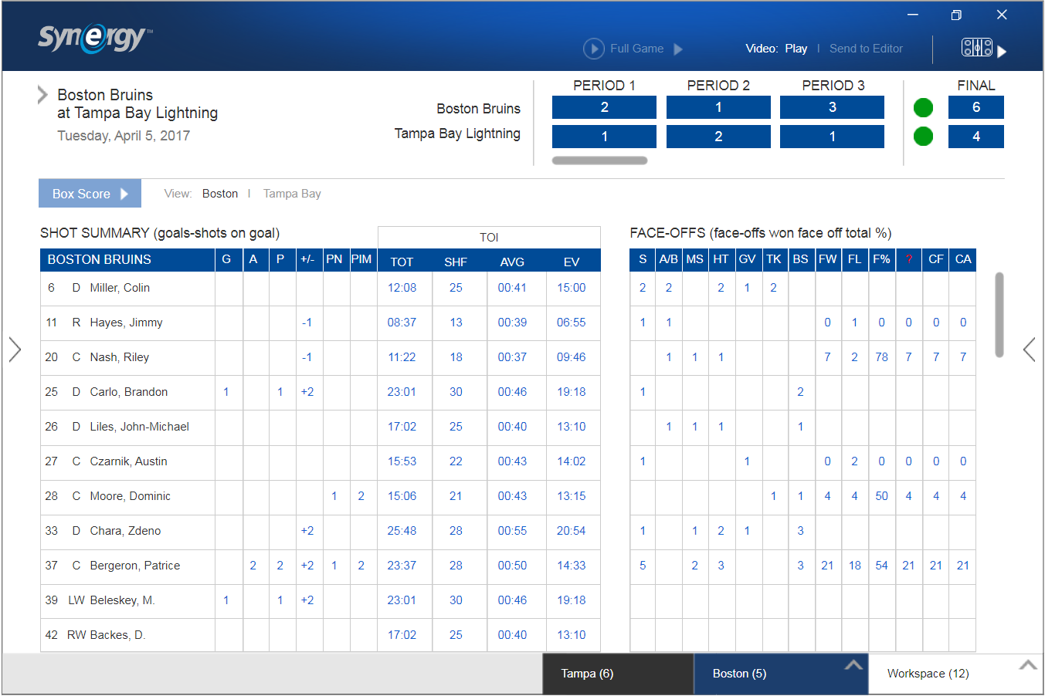

Slide 14
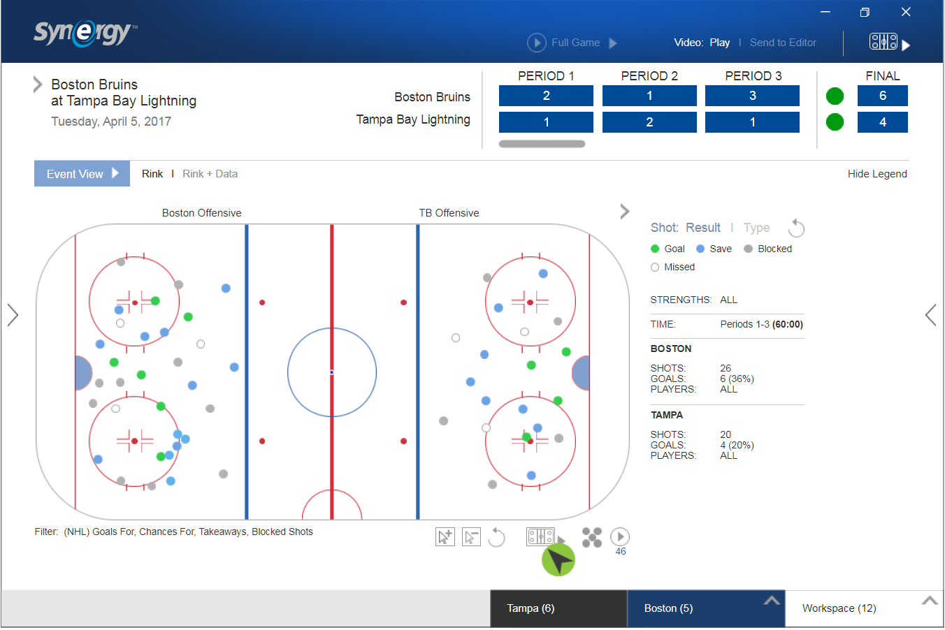

Slide 15
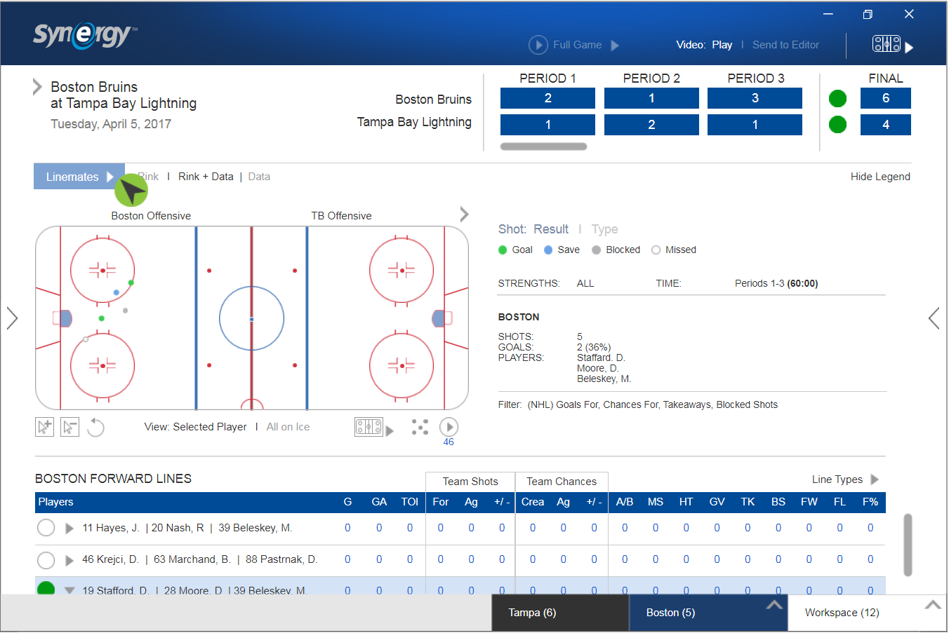

Slide 16
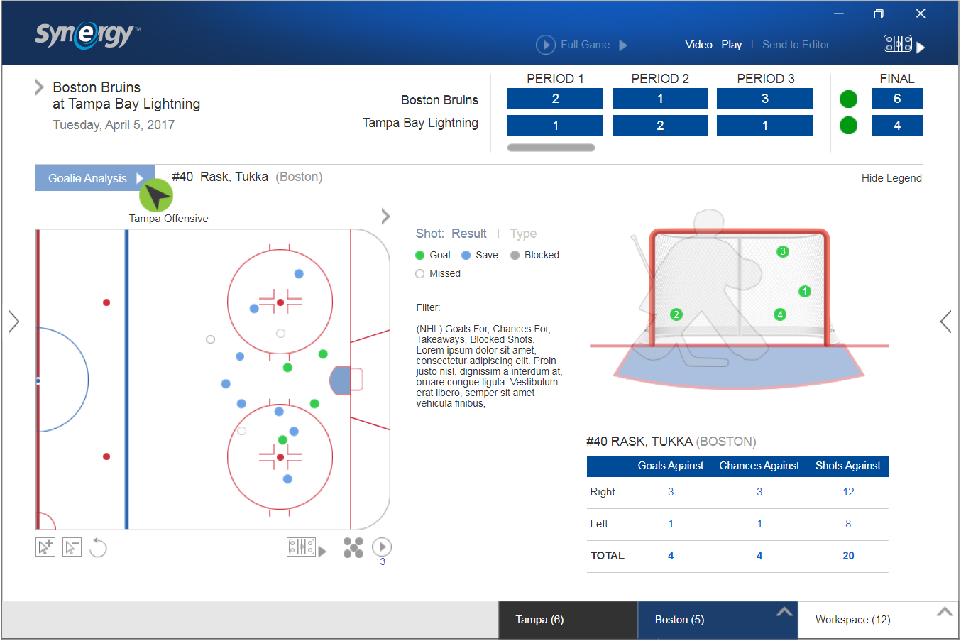

Slide 17
Synergy uses the game video to create data reports
Video association with every event
Multiple reports available to each game
Reports include, but are not limited to
Event Box Score Reports
Event Plotting Map
Goalie analysis
Linemates analysis
Play by Play and more

Slide 18
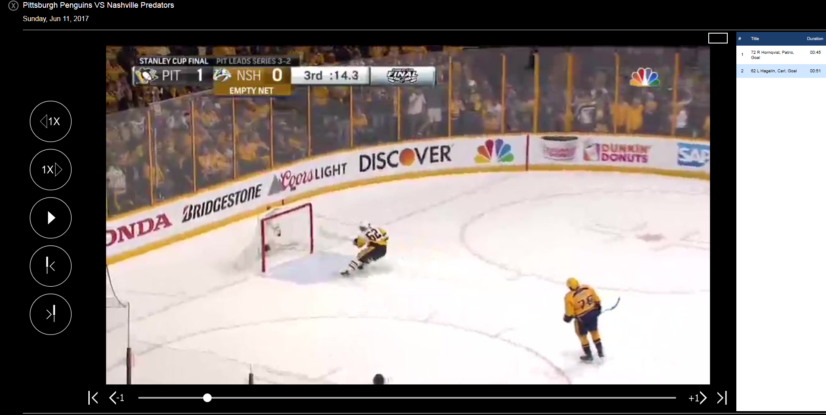

Slide 19
Synergy Hockey
Bob Teofilo
www.synergysportstech.com
bob@synergysportstech.com

